Slide 1

Silicon Valley
Alex Matthiessen, Christopher Newbolt, Elliott Jackson, Fahim Rahman, Weijing Zhang

Slide 2
Defining our Ask
How has average income varied throughout the years? What is the comparison between age groups, races, and industry?

Slide 3
Hypothesis
Roughly over the past 10 years we suspected that the Gender Gap will decrease as pay will be more determined based on experience and education.
Over the past 5 years, people in industries with a computer / engineering focus will have a higher income.

Slide 4
Data Retrieval Process
Identify how to segment the data for the data pulls
By Gender, Age, Race, Industry, and Outlier (NBA)
Locate the source of the Data and extract information to local drives
Data came from Bureau of Labor Statistics, Data – World, and Basketball statistics and history
Identifying the restrictions of each data set and implement data extraction code

Slide 5
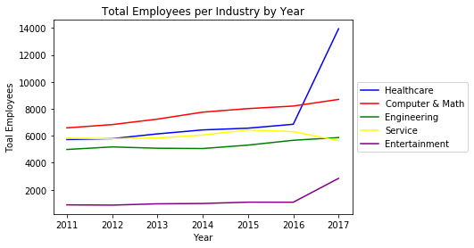
Total Employees
Spike in total number of employees in healthcare
More professionals are joining computer and math ‘type’ jobs.
Engineering steadily increasing (slower rate of growth due to educational requirements)

Slide 6
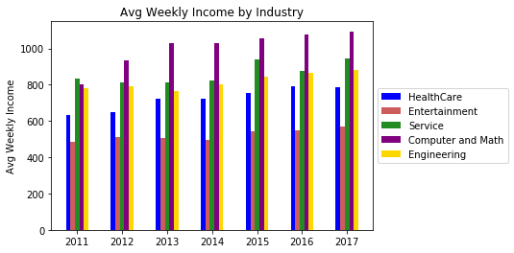
Weekly Income by Selected Industries
Findings
Computer and Mathematics industry saw the greatest average income increase over the past 7 years
Jobs in healthcare seeing increase payment. (Insurance and booming medical manufactures)
Biggest surprise in this analysis was the average income in service is greater than engineering.

Slide 7
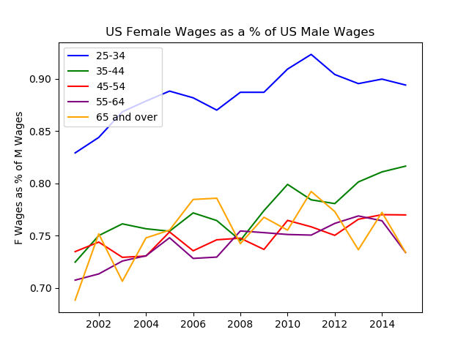
Female Wage as Percentage of Male Wage
The gender wage gap across all age groups has decreased over the last 15 years
The younger the age group the faster the wage gap shrinks

Slide 8
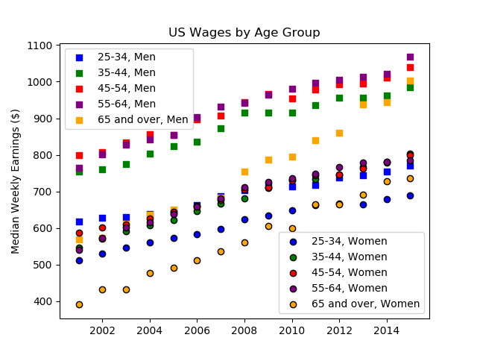
US Wages by Age Group and Gender
The gender gap in median wages for the 35-44, 45-54, and 55-64 year old age groups is very similar
The gender gap in wages for 25-34 year olds is significantly smaller than other age groups
In the last five years the gender gap in median wages for those 65 and older has increased significantly

Slide 9
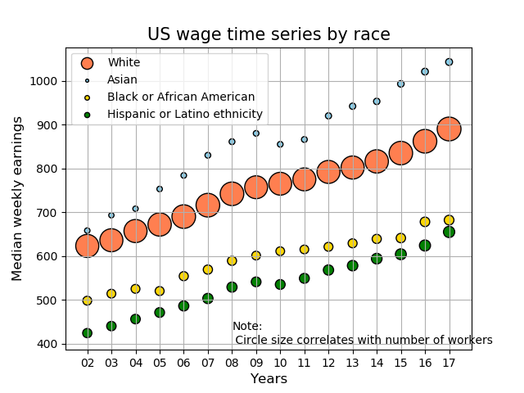
US wage by race
The general trend is increasing weekly earnings
During 2010, all races have a lower growth rate , the Asian and Hispanic or Latino groups even have a negative growth in US

Slide 10
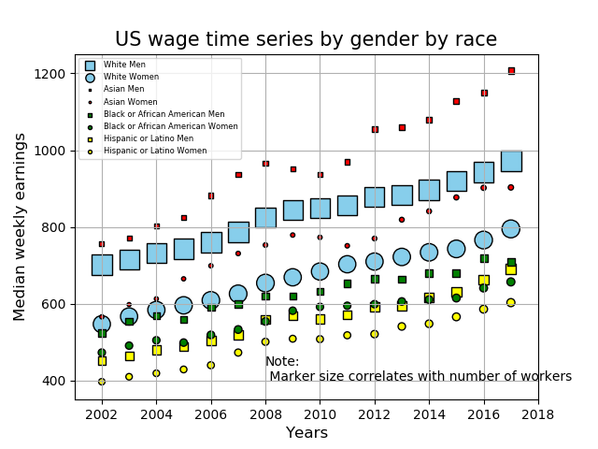
US wage by race of gender
In each Group of Asian men has the highest weekly earnings from 2002 to 2018 in US, it also has the maximum growth rate and lowest workers compared to other groups.
Men has higher income than women in US.

Slide 11
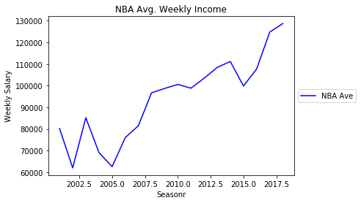
NBA Average Weekly income
NBA Average Salaries are obvious an outlier to the rest of the country.
Average pay for “Ballers” is on the rise much like the rest of the industries, but it does show fluctuations.
Once we get to 2002, there were very few Ballers in the sample, as the average life of a player is short.
Note: Data was reduced by filtering only players who have a 2018 Salary

Slide 12
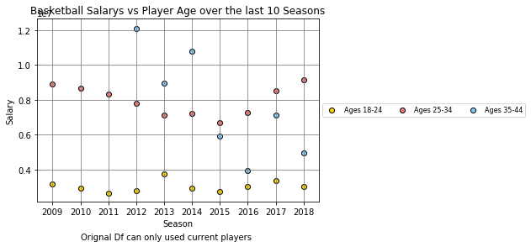
NBA Salaries vs Player Age
NBA pay is clearly dominated by veterans which makes sense.
Seems like the overall bucket of salaries is constant per play age group.
I probably should have created more age brackets because the player lifespan is so short
If there are older plays who get a contract, they normally have a really large salary. (Consider that these Bins actually an average of all players in those age ranges.

